Slide 1
CHINOOK ANALYSIS
Data Analysis with SQL
Class: DT2201L
Group: 6

Slide 2
TEAM MEMBER
Lê Thảo Vy
Nguyễn Văn Khang
Trịnh Đình Hiếu
Trần Trương Minh Thắng

Slide 3
AGENDA
About Chinook
Analysis
Q&A

Slide 4
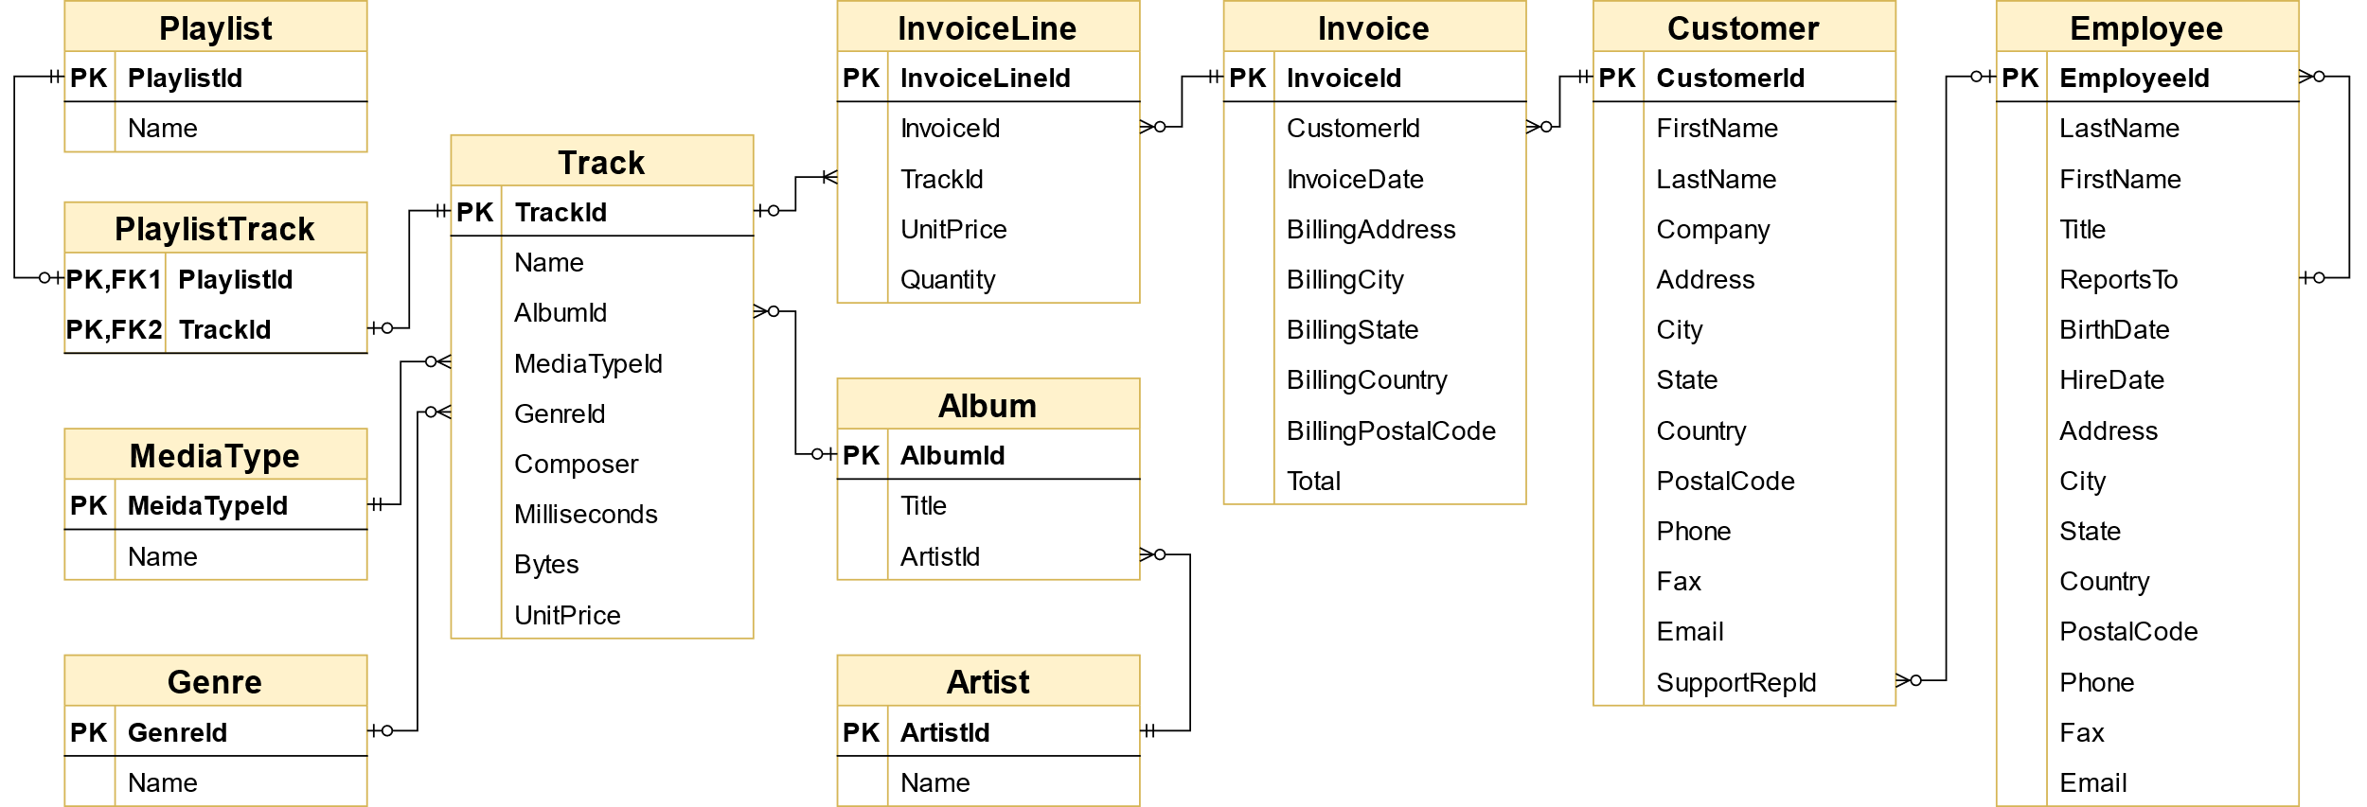
I. ABOUT CHINOOK
The Chinook sample database includes11 tables and 15,000 rows of data
Notes:
The Chinook data model represents a digital media store, including tables for artists, albums, media tracks, invoices, and customers
Media-related data was created using real data from an Apple iTunes library.
Customer and employee information was created using fictitious names and addresses that can be located on Google maps, and other well formatted data (phone, fax, email, etc.)
Sales information was auto generated using random data for a four-year period.
Tên của cơ sở dữ liệu mẫu này được dựa trên cơ sở dữ liệu Northwind. Chinooks là những cơn gió ở phía Tây nội địa của Bắc Mỹ, nơi các thảo nguyên và đồng bằng lớn của Canada gặp nhiều dãy núi khác nhau. Chinooks phổ biến nhất ở miền nam Alberta ở Canada.

Slide 5
II. Analysis Questions
1. Identify which genre sell the most tracks in USA and recommend 3 artists we should buy?
2. Analyzing Sales Agent performance
3. Analyzing Sales by country
4. Should we change purchasing strategy from buying a whole album to purchasing only the most popular tracks from album?
5. Which artist is used in the most playlists?
6. How many tracks have been purchased vs not purchased?
7. Is the range of tracks in the store reflective of their sales popularity?
8. Do protected vs non-protective media types influence popularity?

Slide 6
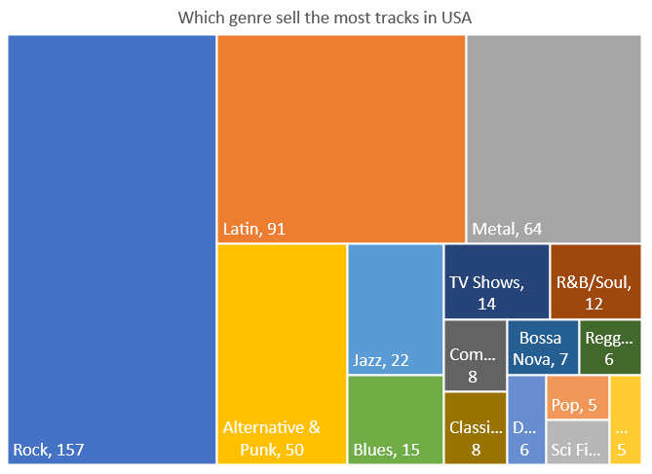
1.1. Which genre sell the most tracks in USA
Top 3 genre have most sells is Rock, Latin, Metal

Slide 7




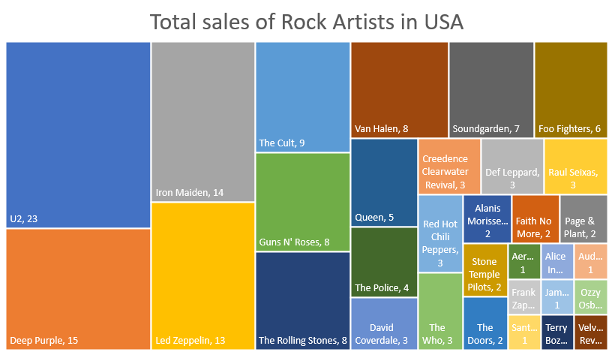
1.2. Recommend 3 Rock artists we should buy in USA
U2
Deep Purple
Iron Maiden

Slide 8
2. Analyzing Sales Agent performance
Identify performance through employee's seniority, Total Sales, Total Customer
Sale agent name | Hire Date | No of sales | No of customers | Total Revenue | Revenue/invoice
Steve Johnson | 2003-10-17 | 126 | 18 | 720.16 | 5.72
Margaret Park | 2003-05-03 | 140 | 20 | 775.40 | 5.54
Jane Peacock | 2002-04-01 | 146 | 21 | 833.04 | 5.71
Notes:
Comment:
Jane Peacock is the first sale agent of store and she has the highest revenue as well as number of customers and total invoices.
Although Steve Johnson is the newest sale agent, but he has the highest Revenue/invoice. He is the employee with the best performance.

Slide 9

2. Analyzing Sales Agent performance
Jane Peacock is senior employee joined from 04/2002
Steve Johnson is the newest employee joined 10/2003
→ Steve Johnson is the best performance
Notes:
So sánh về số lượng khách hang và số lượng invoice
Nhưng ta cần nhớ Jane Peacock gia nhập cty sớm nhất nên số lượng này như này rất dễ hiểu, và Steve Johnson làm rất tốt khi gần bắt kịp
Nếu so sánh theo tỉ lệ doanh thu / invoice thì Steve Johnson tốt nhất
Kết luận Steve Johnson best

Slide 10
3. Analyzing Sales by Country
USA has the highest values in total customers, total sales
Czech has the highest AVG order value and AVG value of sale/customer but only have 2 customers
Notes:
USA has the highest values in total customers, total sales.

Slide 11
4. Albums vs Individual Tracks
Invoice Id | Album Id | Invoice track count | Album track count
1 | 2 | 1 | 1
1 | 3 | 1 | 3
2 | 1 | 4 | 10
3 | 4 | 2 | 8
3 | 5 | 4 | 15
4 | 6 | 2 | 13
4 | 7 | 2 | 12
4 | 8 | 2 | 14
4 | 9 | 2 | 8
4 | 10 | 1 | 14
Now we will divide into 2 cases:
album_track_count = invoice_track_count AND invoice_track_count > 1.
→ Buying whole album.
album_track_count <> invoice_track_count OR invoice_track_count = 1.
→ Buying individual tracks.
Notes:
Giải thích là tạo ra bảng này trước rồi từ đó so sánh ra kết quả

Slide 12
4. Albums vs Individual Tracks
Customer only buy individual tracks, no one buy whole album
CHANGE STRATEGY
→ Purchase only the most popular tracks from each album

Slide 13
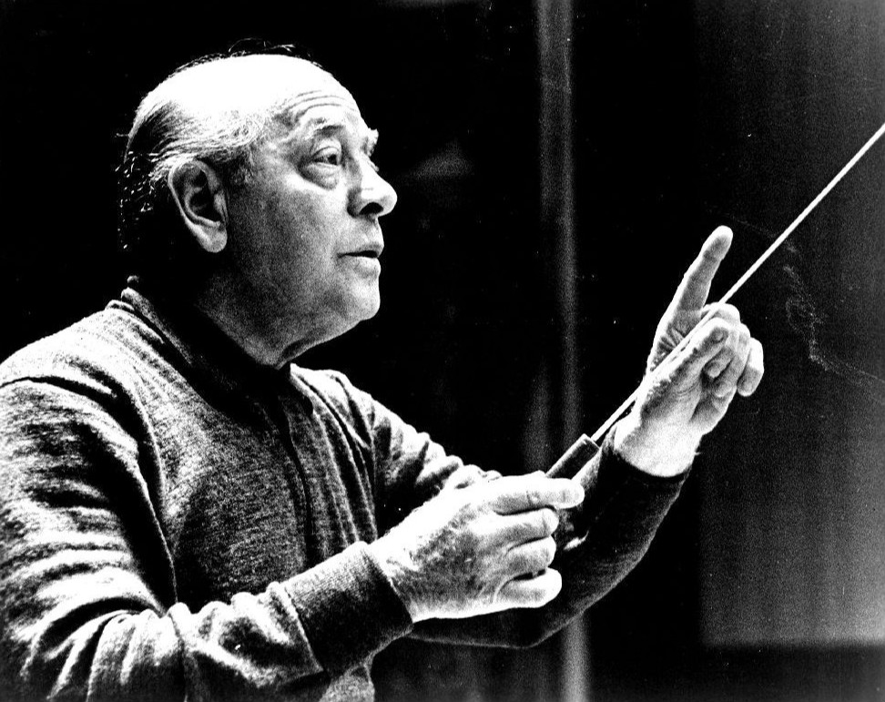
5. Which artist is used in the most playlists?
Track Name | PlayListId
Jupiter, the Bringer of Jollity | 1
 | 5
 | 8
 | 12
 | 15
On the Beautiful Blue Danube | 1
 | 5
 | 8
 | 12
 | 14
Pini Di Roma (Pinien Von Rom) I Pini Della Via Appia | 1
 | 5
 | 8
 | 12
 | 13
Eugene Ormandy appeared in 7 playlists: 1, 5, 8, 12, 13, 14, 15
He was a Hungarian-born American conductor and violinist, best known for his association with the Philadelphia Orchestra, as its music director.
Notes:
Conductor: nhạc trưởng

Slide 14
6. How many tracks have been purchased vs not purchased?
In total 3503 tracks in track table:
+ 1984 tracks have been purchased
+ 1519 tracks have never been bought by anyone

Slide 15
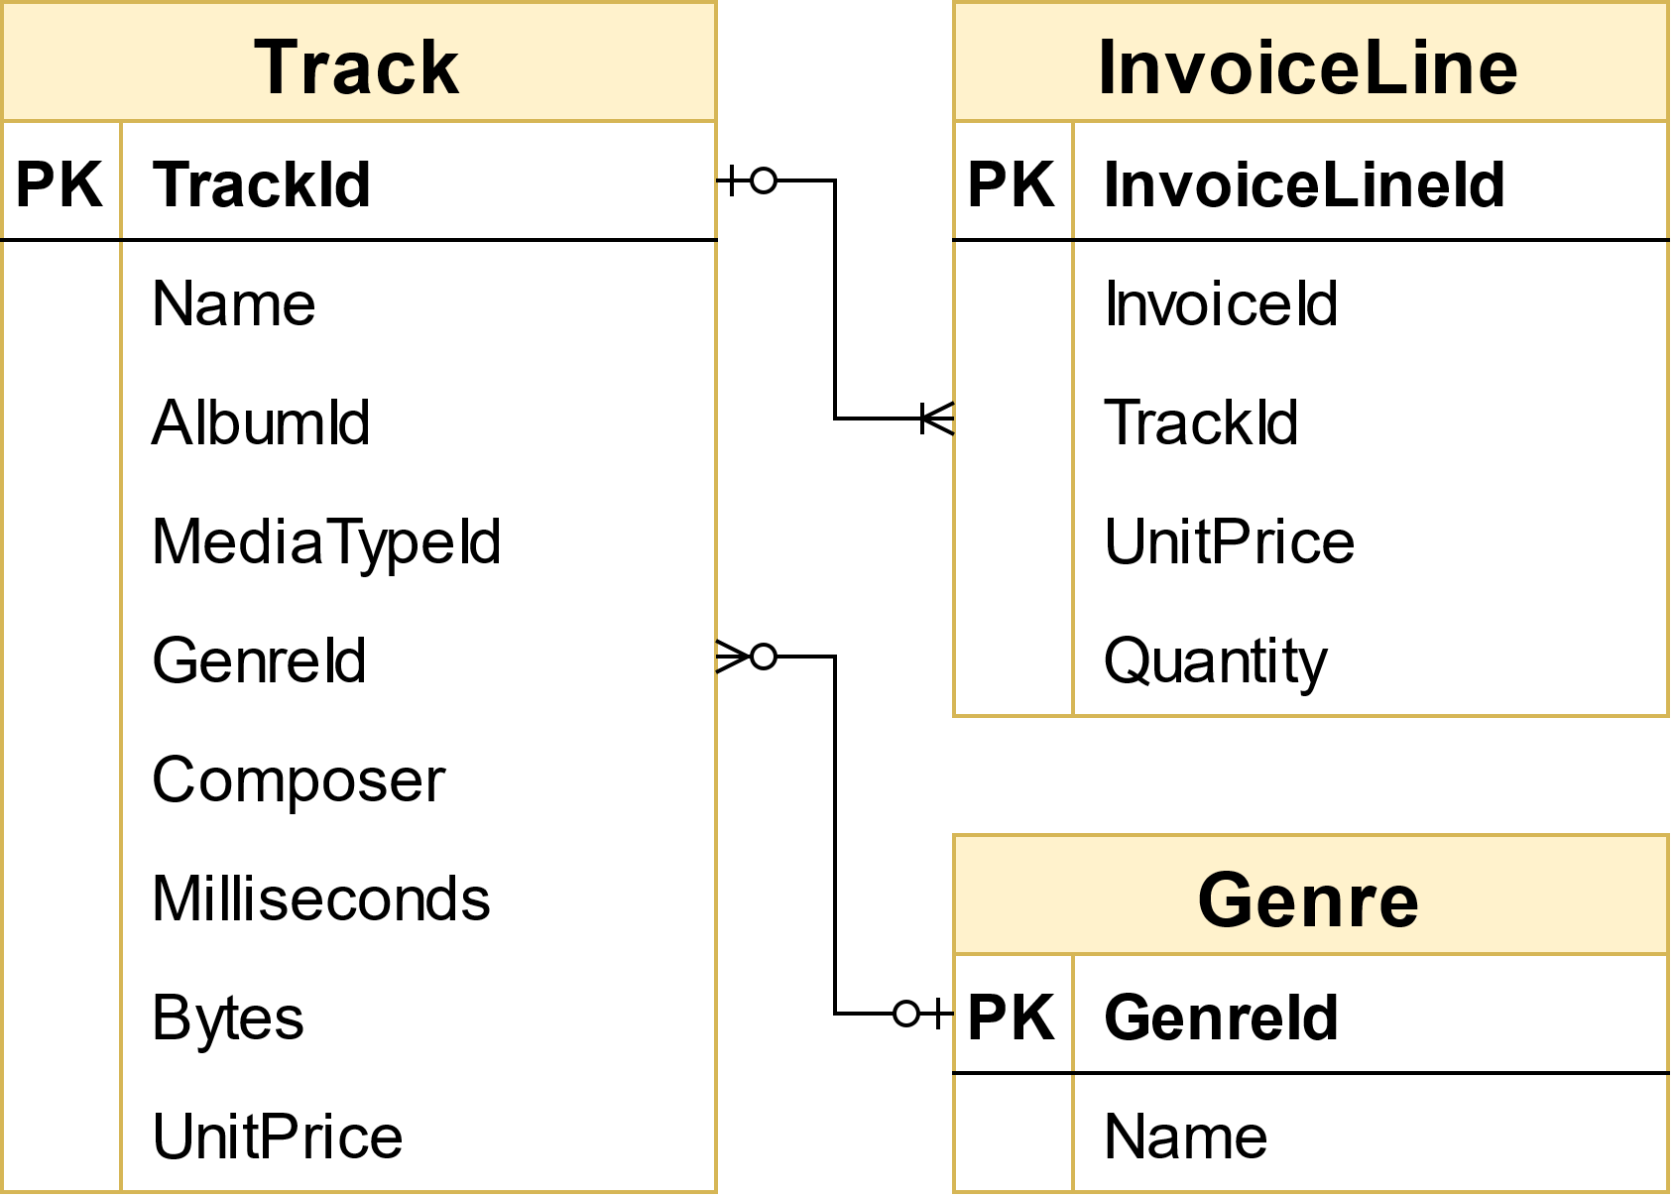
7. Is the range of tracks in the store reflective of their sales popularity?
Choose Genre to group by.
Need to find out:
How many tracks are sold for each genre?
How many tracks in each genre?
→ Determine the percentage of songs that have been sold
Notes:
So sánh trong một thể loại nhạc, thì bao nhiêu phần trăm những bài hát đc bán

Slide 16
7. Is the range of tracks in the store reflective of their sales popularity?

Slide 17
7. Is the range of tracks in the store reflective of their sales popularity?
Notes:
- We can see percentage of sold tracks by genres are around 50%
- Only 2 cases in genre Bossa Nova (15 tracks) and SciFi & Fantasy (26 tracks) has proportion is over 70%, however, their number of total tracks is not much.
- Especial, nobody buy Opera track – and it is only has 1 track.
→ Range of tracks in store is not reflective sales popularity

Slide 18
8. Do protected vs. non-protected media types influence popularity?
Customers tend not to care about whether their track’s format are protected or not.
More than 4/5 clients still purchase non-protected ones.

Slide 19
Q&A

